Slide 1

Chapter 4：Hashing

Slide 2
Main
4.1 Hash table
4.2 Hash function
  4.2.1 direct addressing (直接定址法)
  4.2.2 divided and get the remainder (除留余数法)
  4.2.3 Digital analysis (数字分析法)
  4.2.4 folding method (折叠法)
  4.2.5 Mid-Square (平方取中法)
4.3 Hash Collisions
  4.3.1 Open addressing (开放定址法)
    Linear Probing (线性探测法)
    Quadratic Probing （平方探测法）
  4.3.2 separate chaining (链地址法)
4.4 Realizing
4.5 search performance

Slide 3
4.1 Hashing
Hash funtion:
  H(key) : K→D ，key∈K
  D : addresses in table
add = f (key)
Hash table : based on Hash funtion

Slide 4
Example:
Create a hash table with an address range of 13
The hash funtion:
H(key) = ⎣Ord(The first letter of the key)-1)/2⎦
Ord(...): order number of letters in the alphabet。
Such as : Ord(‘A’)=1
Insert these keyword into the hash table : Zhao, Qian, Sun, Li, Wu, Chen, Han
H(Zhao) = ⎣Ord(‘Z’)-1)/2⎦ = ⎣(26-1)/2⎦ =12
Put the Zhao into address 12
Results:
Chen
Han
Li
Qian
Sun
Wu
Zhao

Slide 5
Conflict and Synonyms
Conflict (冲突)
if key₁≠key₂ , but H(key₁) = H(key₂)，
Keys with the same hash function value are named Synonyms (同义词). such as key₁ and key₂
For examlpe:
Insert Xie into the table. H(Xie) = 11.
However, address 11 has been occupied by Wu.
Xie and Wu are Synonyms . H(Xie) = H(Wu)
Chen
Han
Li
Qian
Sun
Wu
Zhao

Slide 6
How to avoid conflict
Change to another hash function：
H(key) = Ord(The first letter of the key)%13
H(Xie) ≠ H(Wu)
However, if insert Dai，H(Dai) = 4 = H(Qian) ,
conflicting again.
In general, conflict is actually unavoidable
Zhao
Chen
Qian
Sun
Han
Wu
Xie
Li

Slide 7
4.2 Hash funtion
direct addressing (直接定址法)
  Perfect Hashing
divided and get the remainder (除留余数法)
Digital analysis (数字分析法)
folding method (折叠法)
Mid-Square (平方取中法)

Slide 8
4.2.1 direct addressing (直接定址法)
Use the keyword key as the hash address：H(key)=key。
Example:
Children's Demographic Table: The number of children aged 0 to 12 was recorded. Use age as keywords
H ( age ) = age .
地址 | 0 | 1 | … | 11 | 12
年龄 | 0 | 1 | … | 11 | 12
人数 | 980 | 800 | … | 495 | 107

Slide 9
direct addressing
usually，Hash funtion of Direct Addressing would be a linear function:
H(key) = a × key + b
Example:
Statistics of the number of employees of all ages : the ages from 18 to 65. The hash funtion could be:
H (age) = age -18 ; a =1 , b = -18
地址 | 0 | 1 | … | 46 | 47
年龄 | 18 | 19 | … | 64 | 65
人数 | 12 | 25 | … | 23 | 20

Slide 10
4.2.2 divided and get the remainder (除留余数法)
suppose : Address range (地址区间长度) is m .
divided and get the remainder :
Take a number p not bigger than m as the module，then the hash funtion: H(key) = key % p , (p≤m)
The p should be a prime number (质数、素数).
地址区间长度m | 8 | 16 | 32 | 64 | 128 | 256 | 512 | 1000
模 p | 7 | 13 | 31 | 61 | 127 | 251 | 503 | 997

Slide 11
4.3 Hash Collisions
  4.3.1 Open addressing (开放定址法)
    Linear Probing (线性探测法)
    Quadratic Probing （平方探测法）
  4.3.2 separate chaining (链地址法)

Slide 12
4.3.1．Linear Probing (线性探测法)
Suppose : Address range (地址区间长度) is m
H_{i} = (H(key)+i ) % m , 1≤i≤m-1
inside: H_{i} : Indicates the address of the ith detection in case of collisions

Slide 13
Linear Probing
Example:
Suppose address range of the hash table is m = 11.
Hash funtion : H(key) = (3*key) %11
There are 8 keywords : 22, 41, 53, 46, 30, 13, 12, 67
Using linear probing to resolve Collisions
0
1
2
3
4
5
6
7
8
9
10
22
41
30
12
53
46
13
67

Slide 14
Quadratic Probing (二次探测法)
Quadratic Probing (二次探测法、平方探测法)
H_{i} = (H(key)+d_{i}) %m 1≤i≤m-1
其中，d_{i} = 1², -1², 2², -2²,…, k², -k² (k≤m/2)， 即
H = H(key),
H₁ = (H +1²) % m ,
H₂ = (H -1²) % m ,
H₃ = (H +2²) % m ,
H₄ = (H -2²) % m
…

Slide 15
Quadratic Probing
Same example ：
8 Keywords : 22, 41, 53, 46, 30, 13, 12, 67，
m = 11，H(key) = (3*key) %11
Using Quadratic Probing to resolve Collisions
0
1
2
3
4
5
6
7
8
9
10
22
41
30
12
53
46
13
67

Slide 16
Open addressing
The delete operation
Mark delete flag， when deleting a elem

Slide 17
4.3.2 separate chaining (链地址法)
Records whose keywords are synonyms are linked in the same single linked list.
suppose address range of the hash table is m
Using pointer array : T [0...m-1]
Set the initial value of each elem in T as null

Slide 18
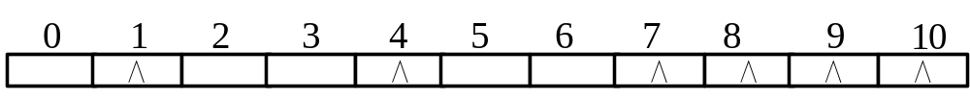
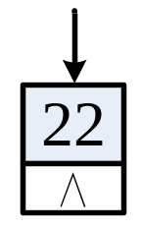
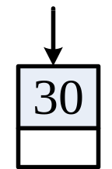
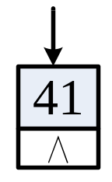
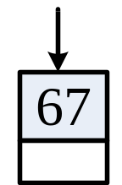
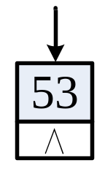
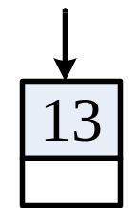
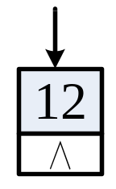
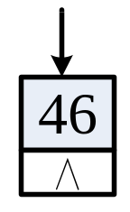
separate chaining
Example:
8 Keywords : 22, 41, 53, 46, 30, 13, 12, 67，
m = 11，H(key)=(3*key) %11，
Using separate chaining to resolve Collisions.
∧
∧
∧
∧
∧

Slide 19
4.4.1 Realizing
separate chaining (链地址法)
  typedef struct Node {
  RcdType r;
  struct Node *next;
  } Node;
  typedef struct {
  Node **rcd;
  int size; // 哈希表容量
  int count; // 当前表中含有的记录个数
  int (*hash)(KeyType key, int); // 函数指针变量，用于选取的哈希函数
  } HashTable;
0
1
2
size-1
∧
∧
∧
……
∧

Slide 20
Operations/ interfaces
Status InitHash(HashTable &H, int size, int (*hash)(KeyType,int)); // 初始化哈希表
Status DestroyHash(HashTable &H); // 销毁哈希表
node* SearchHash(HashTable H, KeyType key); // 查找
Status InsertHash(HashTable &H, RcdType e); // 插入
Status deleteHash(HashTable &H, KeyType key, RcdType &e); // 删除

Slide 21
  Open addressing (开放定址法)
typedef struct {
KeyType key; // 关键字项
… //其它数据项
} RecordType, RcdType;
typedef struct {
RcdType *rcd; // 记录存储基址，动态分配数组
int size; // 哈希表容量
int count; // 当前表中含有的记录个数
int *tag; //标记， 0：空； 1：有效；-1：已删除
} HashTable;

Slide 22
Operations/ interfaces
Status InitHash(HashTable &H, int size, int (*hash)(KeyType, int), void (*collision)(int &, int));//初始化哈希表
Status DestroyHash(HashTable &H);//销毁哈希表
Status CreateHash(HashTable &H);//构造哈希表
Status SearchHash(HashTable H, KeyType key, int &p, int &c); //查找
int InsertHash (HashTable &H, RcdType e); //插入
Status deleteHash(HashTable &H, KeyType key, RcdType &e); //删除

Slide 23
4.5 search performance
For the same set of keywords, set the same hash function. If different resoving collisions are used, the actual hash tables will be different, and their average search lengths will also be different.
Suppose the example:
8个Keyword : 22, 41, 53, 46, 30, 13, 12, 67，
H(key) = (3*key) %11，m = 11，
Study the average search length of Linear Probing, Quadratic Probing and Separate Chaining

Slide 24
average search lengths 平均查找长度
Linear Probing (线性探测法)
(22, 41, 53, 46, 30, 13, 12, 67) ，H(key) = (3*key) %11，
ASL(8) =
(1
+1
+1
+1
+2
+2
+2
+6)
/8=2
0
1
2
3
4
5
6
7
8
9
10
22
41
30
12
53
46
13
67
1
0
1
1
1
1
1
1
1
0
0

Slide 25
Average Search Lengths
Quadratic Probing（二次探测法）
(22, 41, 53, 46, 30, 13, 12, 67) ，H(key) = (3*key) %11，
ASL(8) =
(1
+1
+1
+1
+2
+2
+2
+5)
/8=1.875
0
1
2
3
4
5
6
7
8
9
10
22
41
30
12
53
46
13
67
1
0
1
1
1
1
1
1
0
0
1

Slide 26
Average Search Lengths
Separate Chaining（链地址法）
(22, 41, 53, 46, 30, 13, 12, 67) ，H(key) = (3*key) %11，
ASL(8) =
(1
+2
+1
+2
+1
+1
+2
+1)
/8=1.375

Slide 27
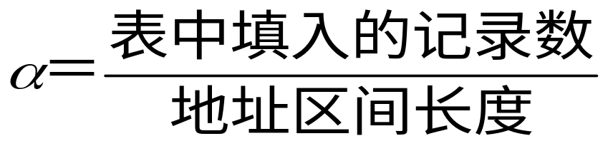
Load Factor (装填因子)
The ratio of the number of records inserted in the hash table to the length of the address range is called the Load factor α :

Slide 28
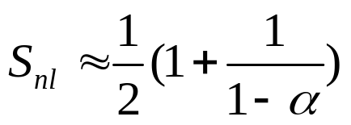
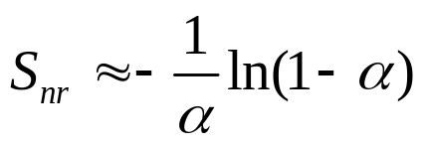
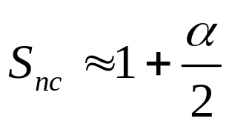
Average Search Lengths
处理冲突方法相同的哈希表，其平均查找长度依赖于α，直观上来看，α越大，发生冲突的可能性就越大。可以证明：
采用线性探测法的哈希表查找成功时的平均查找长度为
采用二次探测法的哈希表查找成功时的平均查找长度为
采用链地址法的哈希表查找成功时的平均查找长度为

